Slide 1
Akuntansi manajemen
Analisis Titik Impas

Slide 2

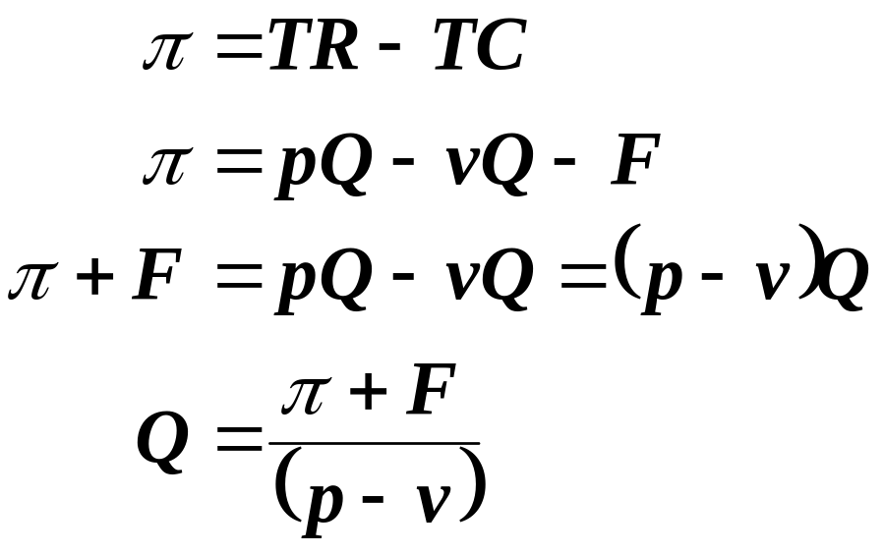
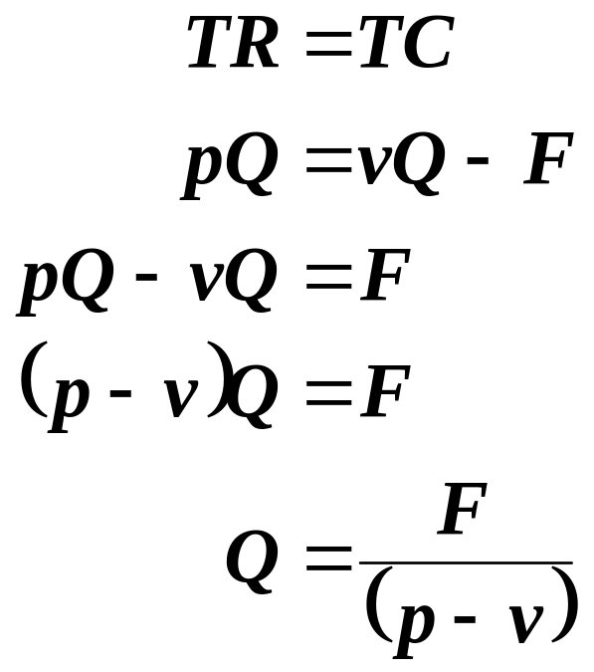
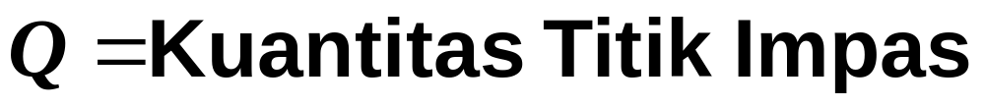
Perhitungan Titik Impas – Cara Matematika
Laba=0

Slide 3
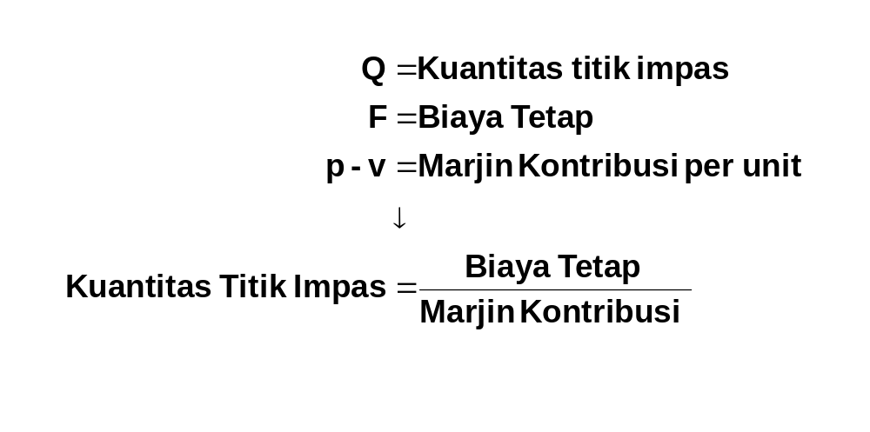
Perhitungan Titik Impas – Cara Matematika

Slide 4
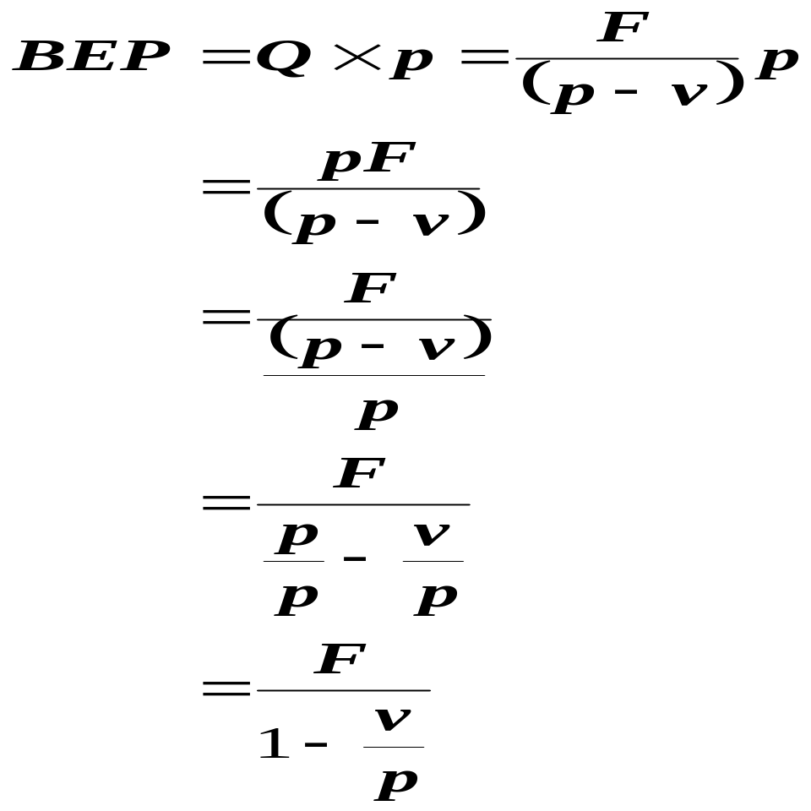


Perhitungan Titik Impas – Cara Matematika
BEP Rupiah = Kuantitas BEP x Harga Jual Per Unit

Slide 5
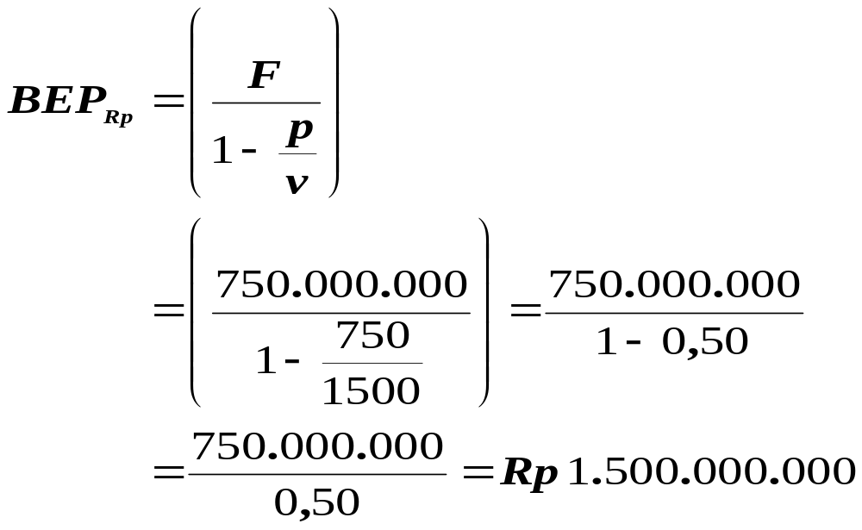
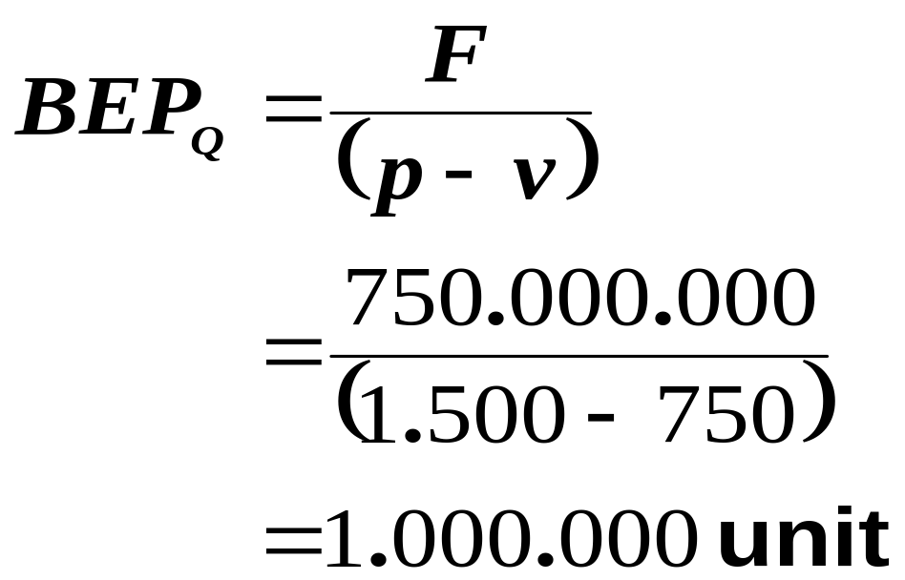
Perhitungan Titik Impas – Contoh
Harga Jual per satuan | 1.500,00
Biaya Variabel per satuan | 750,00
Biaya Tetap | 750.000.000,00
Volume yang direncanakan | 2.500.000 unit

Slide 6
Perhitungan Titik Impas – Cara Grafis
Jumlah Penghasilan
LABA
Jumlah Biaya
2000
1500
Jumlah Penghasilan dan Biaya (Jutaan Rp)
Biaya Variabel
1000
RUGI
Jumlah Biaya Tetap
500
0
500
1000
1500
2000
Volume Penjualan

Slide 7
Perhitungan Titik Impas – Grafik Laba Satuan
750.000
Garis Laba
375.000
Titik impas
0
-375.000
-750.000
250
500
750
1000
1250
1500

Slide 8
Perhitungan Titik Impas – Contoh
Volume | Fixed Costs | Variable Costs | Total Costs | Total Revenue | Laba/Rugi
- | 750,000,000 | - | 750,000,000 | - | (750,000,000)
100,000 | 750,000,000 | 75,000,000 | 825,000,000 | 150,000,000 | (675,000,000)
200,000 | 750,000,000 | 150,000,000 | 900,000,000 | 300,000,000 | (600,000,000)
300,000 | 750,000,000 | 225,000,000 | 975,000,000 | 450,000,000 | (525,000,000)
400,000 | 750,000,000 | 300,000,000 | 1,050,000,000 | 600,000,000 | (450,000,000)
500,000 | 750,000,000 | 375,000,000 | 1,125,000,000 | 750,000,000 | (375,000,000)
600,000 | 750,000,000 | 450,000,000 | 1,200,000,000 | 900,000,000 | (300,000,000)
700,000 | 750,000,000 | 525,000,000 | 1,275,000,000 | 1,050,000,000 | (225,000,000)
800,000 | 750,000,000 | 600,000,000 | 1,350,000,000 | 1,200,000,000 | (150,000,000)
900,000 | 750,000,000 | 675,000,000 | 1,425,000,000 | 1,350,000,000 | (75,000,000)
1,000,000 | 750,000,000 | 750,000,000 | 1,500,000,000 | 1,500,000,000 | -
1,100,000 | 750,000,000 | 825,000,000 | 1,575,000,000 | 1,650,000,000 | 75,000,000
1,200,000 | 750,000,000 | 900,000,000 | 1,650,000,000 | 1,800,000,000 | 150,000,000
1,300,000 | 750,000,000 | 975,000,000 | 1,725,000,000 | 1,950,000,000 | 225,000,000
1,400,000 | 750,000,000 | 1,050,000,000 | 1,800,000,000 | 2,100,000,000 | 300,000,000
1,500,000 | 750,000,000 | 1,125,000,000 | 1,875,000,000 | 2,250,000,000 | 375,000,000
1,600,000 | 750,000,000 | 1,200,000,000 | 1,950,000,000 | 2,400,000,000 | 450,000,000
1,700,000 | 750,000,000 | 1,275,000,000 | 2,025,000,000 | 2,550,000,000 | 525,000,000
1,800,000 | 750,000,000 | 1,350,000,000 | 2,100,000,000 | 2,700,000,000 | 600,000,000
1,900,000 | 750,000,000 | 1,425,000,000 | 2,175,000,000 | 2,850,000,000 | 675,000,000
2,000,000 | 750,000,000 | 1,500,000,000 | 2,250,000,000 | 3,000,000,000 | 750,000,000
2,100,000 | 750,000,000 | 1,575,000,000 | 2,325,000,000 | 3,150,000,000 | 825,000,000
2,200,000 | 750,000,000 | 1,650,000,000 | 2,400,000,000 | 3,300,000,000 | 900,000,000
2,300,000 | 750,000,000 | 1,725,000,000 | 2,475,000,000 | 3,450,000,000 | 975,000,000
2,400,000 | 750,000,000 | 1,800,000,000 | 2,550,000,000 | 3,600,000,000 | 1,050,000,000
2,500,000 | 750,000,000 | 1,875,000,000 | 2,625,000,000 | 3,750,000,000 | 1,125,000,000

Slide 9
Analisis Sensitivitas
F | v |  | Volume penjualan yang harus diperoleh pada tingkat laba (asumsi harga jual tetap)
 |  | MK | - | 100,000,000 | 150,000,000 | 200,000,000 | 250,000,000 | 300,000,000
750,000,000 | 750 | 750 | 1,000,000 | 1,133,333 | 1,200,000 | 1,266,667 | 1,333,333 | 1,400,000 | C0
750,000,000 | 825 | 675 | 1,111,111 | 1,259,259 | 1,333,333 | 1,407,407 | 1,481,481 | 1,555,556 | C1
750,000,000 | 900 | 600 | 1,250,000 | 1,416,667 | 1,500,000 | 1,583,333 | 1,666,667 | 1,750,000 | C2
750,000,000 | 675 | 825 | 909,091 | 1,030,303 | 1,090,909 | 1,151,515 | 1,212,121 | 1,272,727 | C3
750,000,000 | 600 | 900 | 833,333 | 944,444 | 1,000,000 | 1,055,556 | 1,111,111 | 1,166,667 | C4
825,000,000 | 750 | 750 | 1,100,000 | 1,233,333 | 1,300,000 | 1,366,667 | 1,433,333 | 1,500,000 | C5
900,000,000 | 750 | 750 | 1,200,000 | 1,333,333 | 1,400,000 | 1,466,667 | 1,533,333 | 1,600,000 | C6
675,000,000 | 750 | 750 | 900,000 | 1,033,333 | 1,100,000 | 1,166,667 | 1,233,333 | 1,300,000 | C7
600,000,000 | 750 | 750 | 800,000 | 933,333 | 1,000,000 | 1,066,667 | 1,133,333 | 1,200,000 | C8

Slide 10
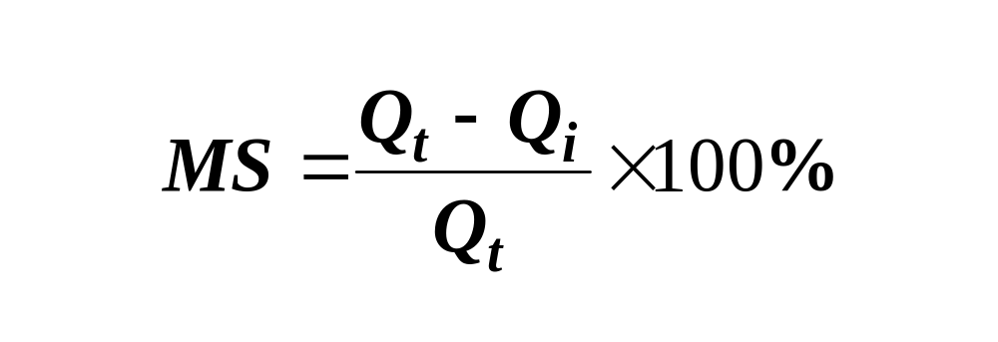
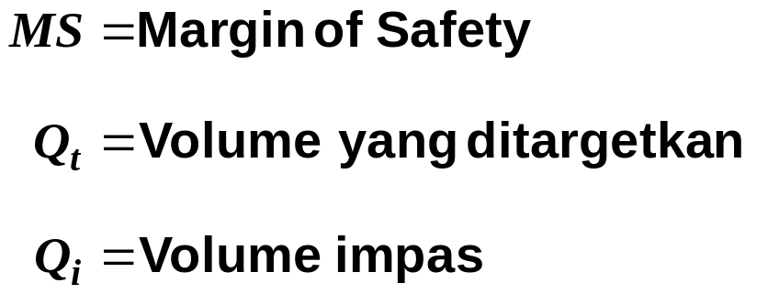
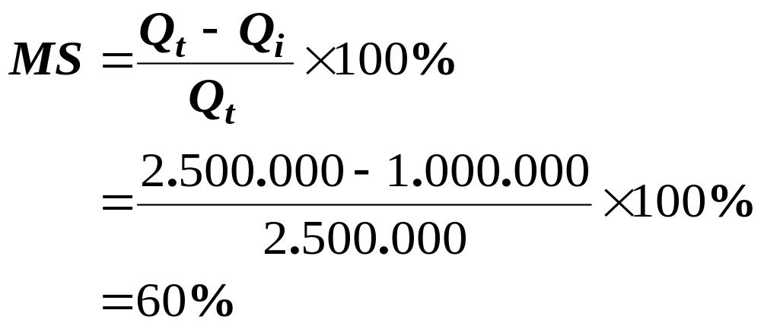
Margin of Safety
Berapa volume penjualan boleh turun tetapi perusahaan tidak mengalami kerugian ?

Slide 11
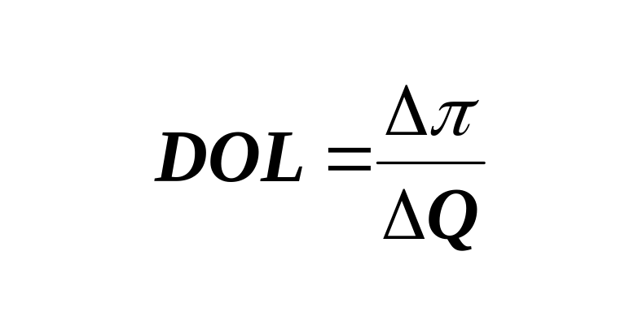
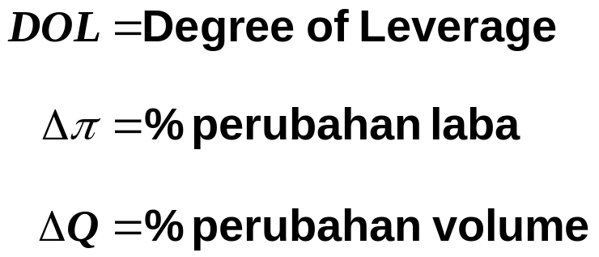
Degree of Leverage
Persentase perubahan pada laba yang diakibatkan oleh perubahan pada volume penjualan
Contoh :
DOL = 3 artinya setiap perubahan 1% pada volume penjualan akan mengakibatkan perubahan laba 3%

Slide 12
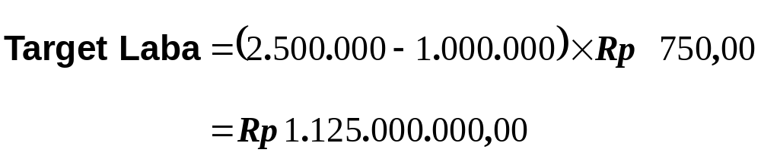
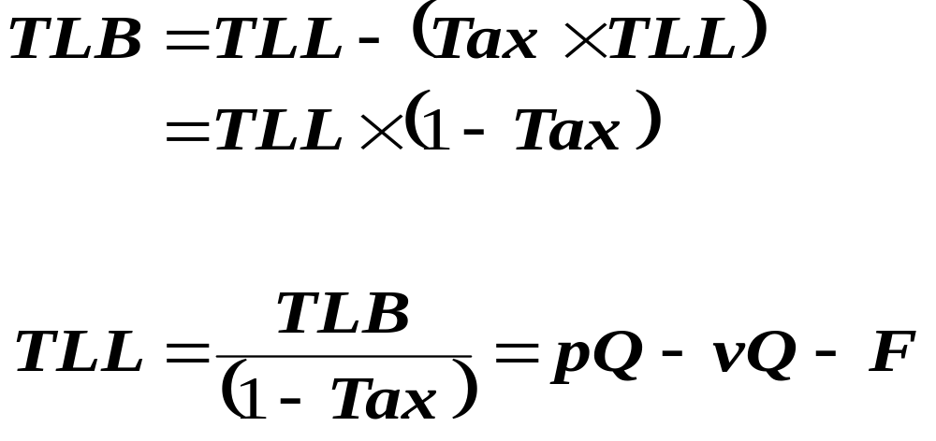
Pengaruh Pajak Penghasilan
Bagaimanakah pengaruh beban pajak penghasilan terhadap titik impas ?
Lihat data di contoh pertama !
Bagaimana kalau ada PPh badan 40%, berapakah volume penjualan harus dicapai agar target laba tidak berubah ?

Slide 13
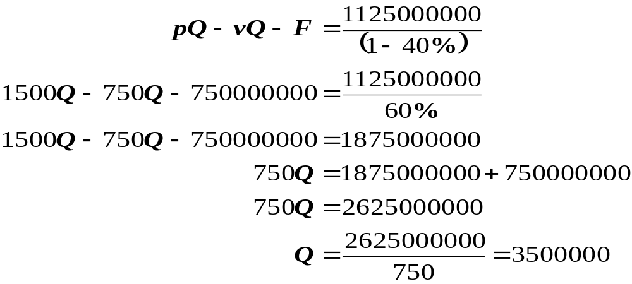
Pengaruh Pajak Penghasilan
Dengan menjual 3.500.000 unit beban pajak 40% tidak akan mempengaruhi target laba Rp 1.125.000.000,00.
Buktikan !!!

Slide 14

TERIMA KASIH

