Slide 1
METODE PENELITIAN
01
THE WAYS OF KNOWING

Slide 2
Mengapa orang melakukan penelitian ?
Fakta
Fakta
Fenomena
Fakta
Rasa ingin tahu
(desire to know something - curiosity)
Mencari tahu
(the ways of knowing)
Fitrah Manusia
The nature of human beeing
Tahu
(knowing)
Merasa benar

Slide 3
Apakah yang kita tahu itu KEBENARAN atau sekedar MERASA BENAR
Indera kita memiliki keterbatasan untuk menangkap ( capture ) realita
Realita tidak seluruhnya dapat diamati – sesuatu yang tidak diketahui bukan berarti tidak ada
Intervensi dari lingkungan
Persepsi
Prior knowledge
Beliefs
Social
Cultural
Truth is most often used to mean in accord with fact or reality, or fidelity to an original or to a standard or ideal. … The concept of truth is discussed and debated in several contexts, including philosophy and religion. Many human activities depend upon the concept, which is assumed rather than a subject of discussion, including science, law, and everyday life.

Slide 4

Bagaimana kita mengetahui sesuatu ?
Myth/Superstition
Coincidence
Common sense
The Ways
of Knowing
Intuitive /
A Priori / Revelation
Trial & Error
Authority
Transcendental
Scientific Method

Slide 5
Myth / Superstition?
Myth : a traditional story about heroes or supernatural beings, often explaining the origins of natural phenomena or aspects of human behavior
.
Superstition :
irrational belief: an irrational but usually deep-seated belief in the magical effects of a particular action or ritual, especially in the likelihood that good or bad luck will result from performing it
irrational beliefs: irrational and often quasi-religious belief in and reverence for the magical effects of certain actions and rituals or the magical powers of certain objects
Microsoft® Encarta® Reference Library 2005. © 1993-2004 Microsoft Corporation. All rights reserved.

Slide 6
Common Sense
Common sense : good judgment: sound practical judgment derived from experience rather than study
Microsoft® Encarta® Reference Library 2005. © 1993-2004 Microsoft Corporation. All rights reserved.
Common sense : We learn by absorving the customs and traditions that surround us

Slide 7
Trial and Error
Trial and Error : trying of different alternatives: a method of finding a satisfactory solution or means of doing something by experimenting with alternatives and eliminating failures
Microsoft® Encarta® Reference Library 2005. © 1993-2004 Microsoft Corporation. All rights reserved.

Slide 8
Intuitive / A priori / Revelation
Intuitive : known automatically: known directly and instinctively, without being discovered or consciously perceived
A priori : based on something known: working from something that is already known or self-evident to arrive at a conclusion
Microsoft® Encarta® Reference Library 2005. © 1993-2004 Microsoft Corporation. All rights reserved.
A priori : knowledge that God reveals about Himself

Slide 9
Authority
source of reliable information: somebody who is accepted as a source of reliable information on a subject, or a book in which such information is given
Microsoft® Encarta® Reference Library 2005. © 1993-2004 Microsoft Corporation. All rights reserved.

Slide 10
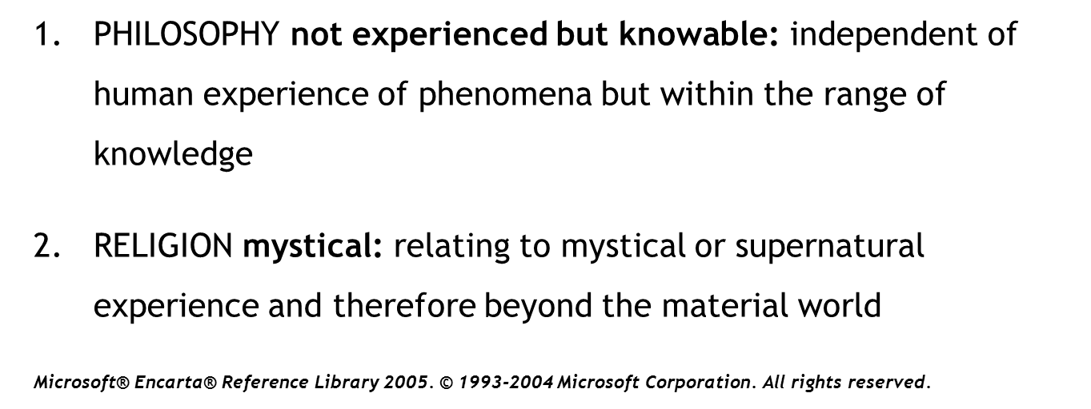
Transcendental

Slide 11
Scientific Method
means of acquiring knowledge scientifically: the system of advancing knowledge by formulating a question, collecting data about it through observation and experiment, and testing a hypothetical answer
Microsoft® Encarta® Reference Library 2005. © 1993-2004 Microsoft Corporation. All rights reserved.
Scientific Research

Slide 12
Science as A Way of Knowing
Objectivity
View the world as it is
Precision
Score = True Measure + Error
Allow others to replicate their studies
Verification
Bases its knowledge on observations of specific events
Empiricism
Theory Construction
Scientific Research

Slide 13
Types of Scientific Research - Quantitative
Historical Research
Answer the question “what was”
Studies documents and relics – eye witness
Second-hand research documents
Answer the question “what is”
Describe present conditions
Descriptive
Comparative
Correlational
Causal
Descriptive Research
Answer the question “what if”
Controlled a treatment as independent variable
Measure its effect on dependent variables
Natural settings
Laboratory settings
Experimental Research
Evaluation Research
Systematic appraisal of a program or product
Research and Development
Application of the scientific method in creating a new product / program

